Slide 1
Grocery Shopping 101
Presented by: Bonnie Giampa and Briar Krieger
Co-founders, 8 Week Challenge Inc.

Slide 2
Grocery Shopping 101
Shop the PERIMETER of the grocery store.
Don’t go shopping on an empty stomach.
Limit your time spent in the aisles.
Buy fresh first, and frozen second.
Read your INGREDIENT lists, don’t focus on the box.

Slide 3
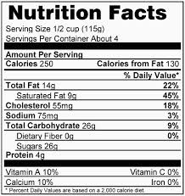
Grocery Shopping 101
Don’t focus on the values, focus on learning the important words to look out for.
To determine how many teaspoons of sugar per serving, simply divide the sugar grams by 4.

Slide 4
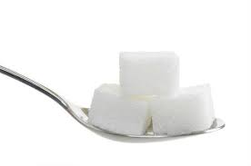
Ingredient List 101
ADDED SUGAR: Look for words like glucose/fructose, high fructose corn syrup, brown rice syrup, sugar, brown sugar, evaporated cane juice, cane juice, aspartame, sucralose etc

Slide 5
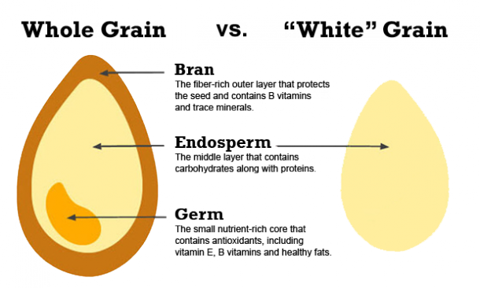
Ingredient List 101
Choose WHOLE GRAINS: Stay away from ingredients that say, enriched white flour, white flour, bleached flour, wheat gluten, and WHEAT FLOUR (aka white flour)

Slide 6
Ingredient List 101
No Trans Fats: Look for the words HYDROGENATED OIL.
In the 1980’s over 9,000 grocery store products contained hydrogenated oil, while today only about 3,000 products contain this trans fat ingredient.

Slide 7
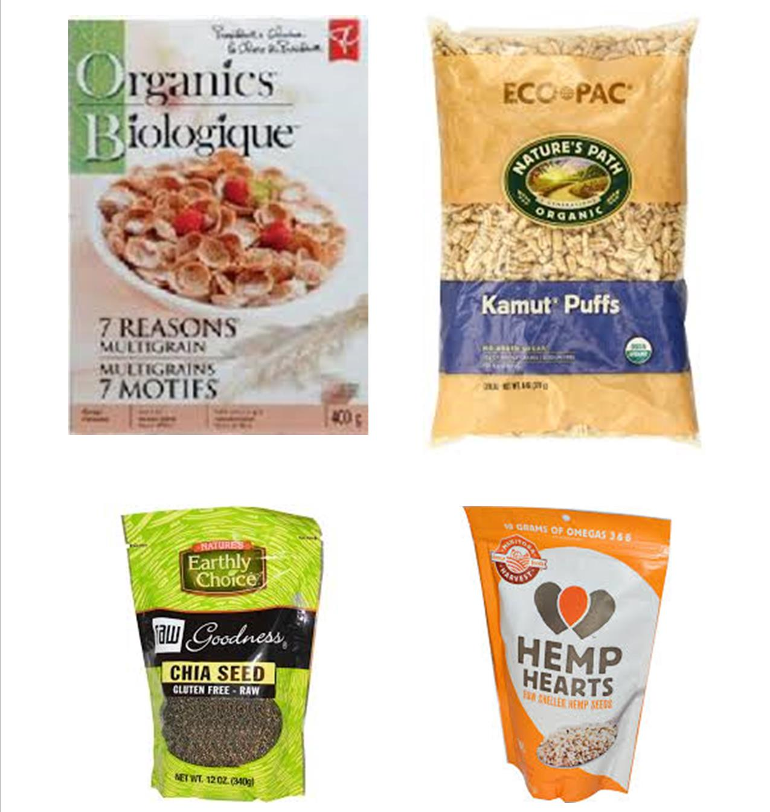
Grocery Shopping 101

Slide 8
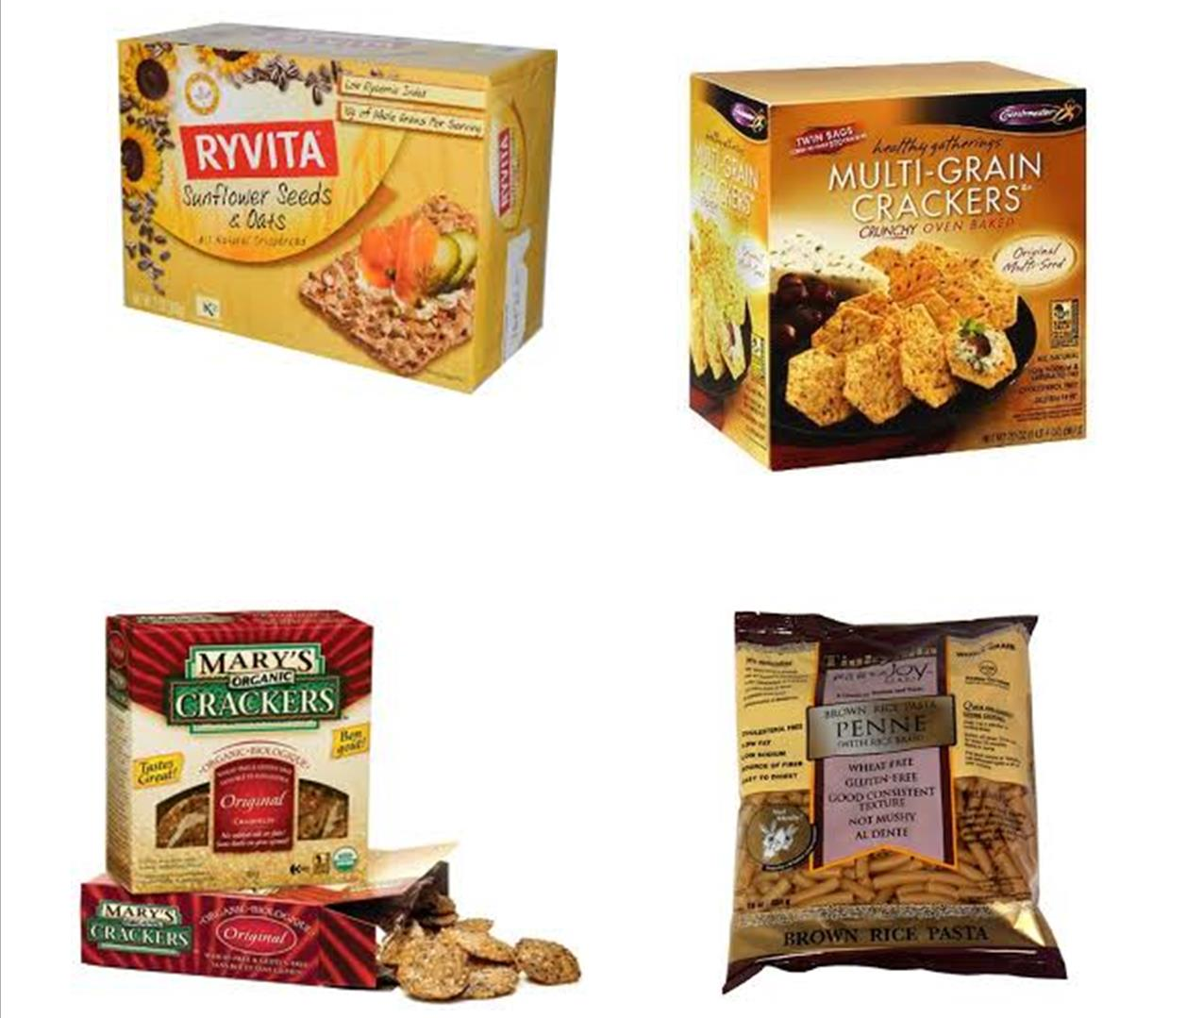
Grocery Shopping 101

Slide 9
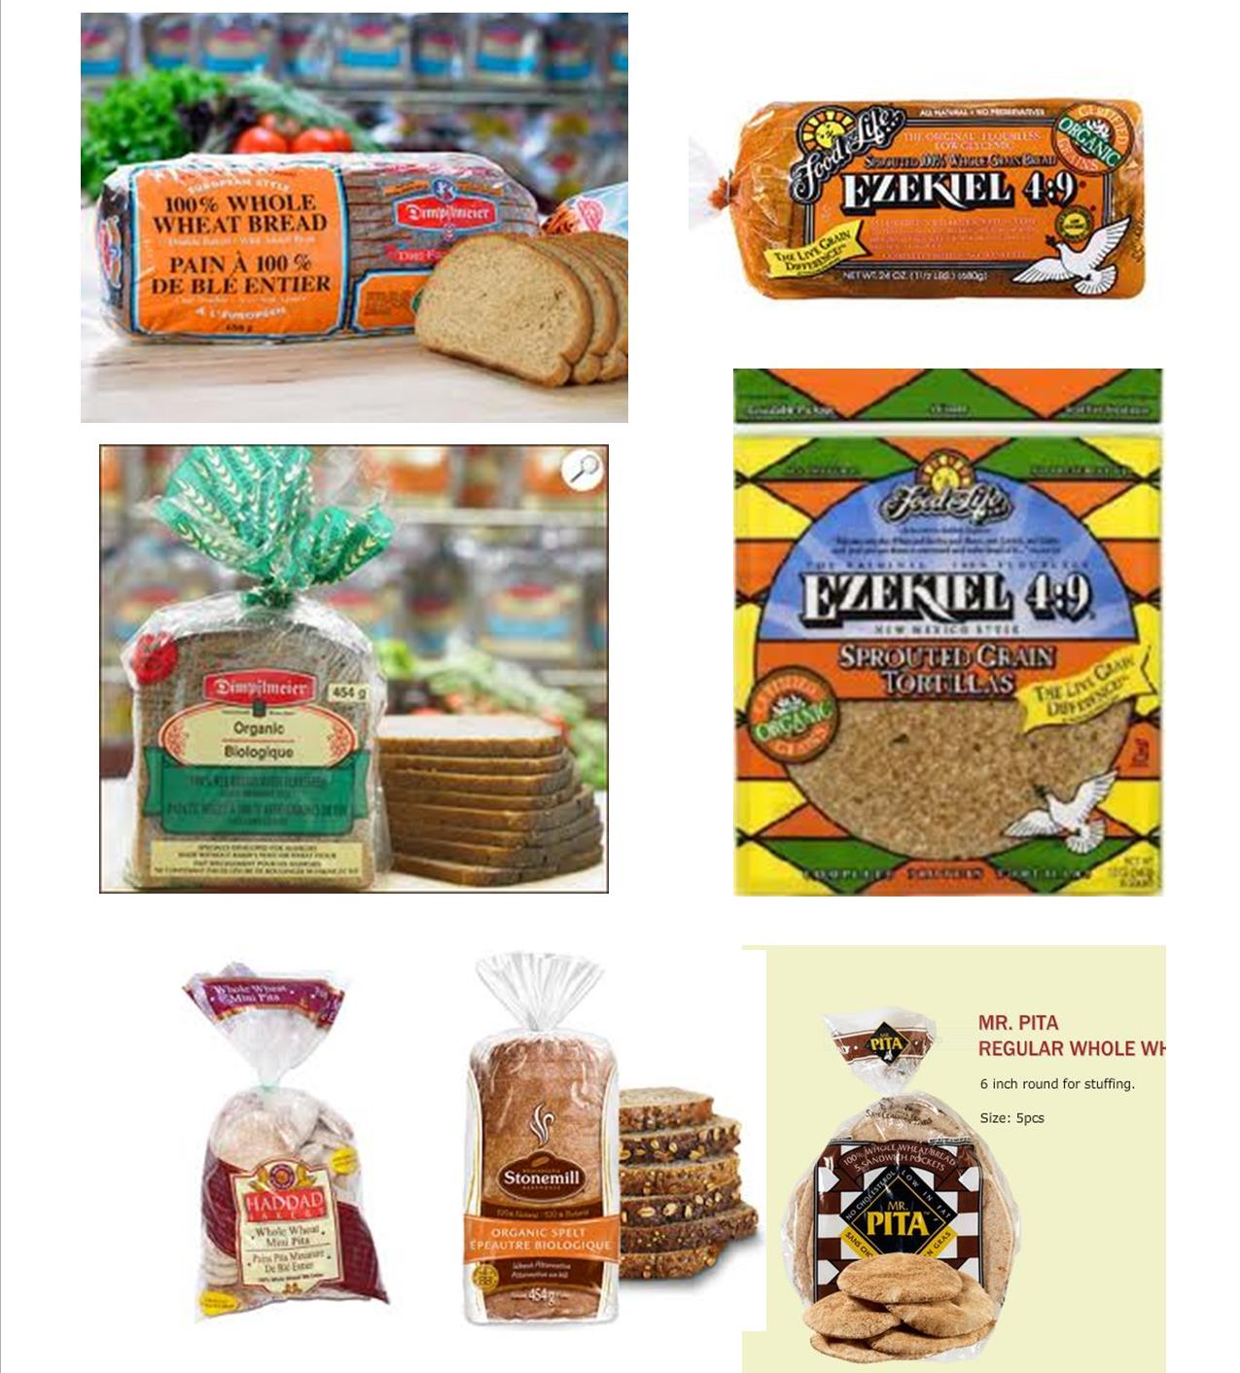
Grocery Shopping 101

Slide 10
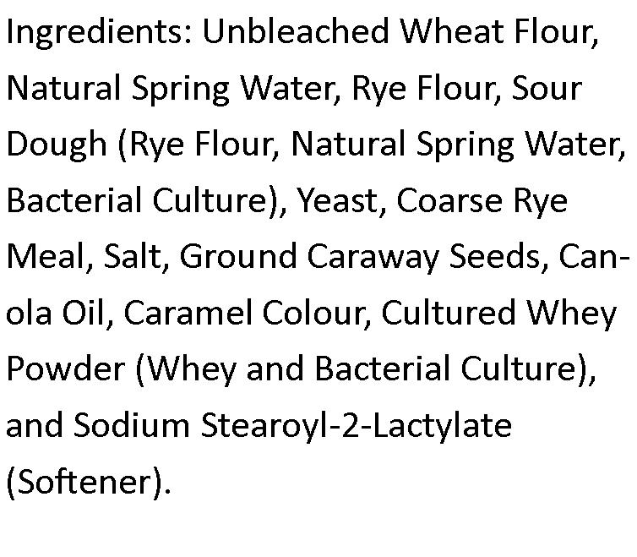
Grocery Shopping 101

Slide 11
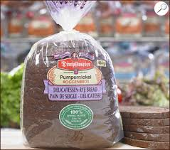
Grocery Shopping 101

Slide 12
Grocery Shopping 101
It’s not a DIET, it’s a way of LIFE!
For more info and recipes please visit our website at www.8weekchallenge.com and our
PINTEREST
http://www.pinterest.com/8weekchallenge/
FACE BOOK https://www.facebook.com/8weekchallengeInc
TWITTER
@8weekchallenge
OR VIA EMAIL
Bonnie@8weekchallenge.com or Briar@8weekchallenge.com

